Slide 1
Center for Science of Information
Structural Information:
Progress Report
Wojciech Szpankowski
Purdue University

Slide 2
Outline
Science of Information
CSoI Team
Research Plan
Research Thrusts
Overview of Research Plan
Legacy & Value Added
TIMES: Temporal Information Maximally Extracted from Structure
Education and Diversity & Knowledge Transfer
Sustainability/Business Plan (Bob Brown)
Management
Budget

Slide 3
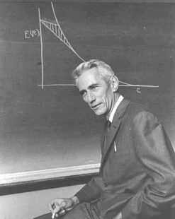
What is Science of Information?
Claude Shannon laid the foundation of information theory, demonstrating that problems of data transmission and compression (i.e., reliably reproducing data) can be precisely modeled formulated, and analyzed.
SCIENCE OF INFORMATION builds on Shannon’s principles to address key challenges in understanding information that nowadays is not only communicated but also acquired, curated, organized, aggregated, managed, processed, suitably abstracted and represented, analyzed, inferred, valued, secured, and used in various scientific, engineering, and socio-economic processes.
CSoI MISSION: Advance science and technology through a new quantitative understanding of the representation, communication and processing of information in biological, physical, social and engineering systems.

Slide 4
Center’s Goals
Extend Information Theory to meet new challenges in
biology, economics, data & social sciences, and physical
distributed systems.
Understand new aspects of information (embedded) in
structure, time, space, semantics,
dynamic information, limited resources, complexity, representation invariant information, and cooperation & dependency.

Slide 5
Outline
Science of Information
CSoI Team & History
Research Plan
Research Thrusts
Overview of Research Plan
Legacy & Value Added
TIMES: Temporal Information Maximally Extracted from Structures
Education and Diversity & Knowledge Transfer
Sustainability Plan
Management
Budget

Slide 6


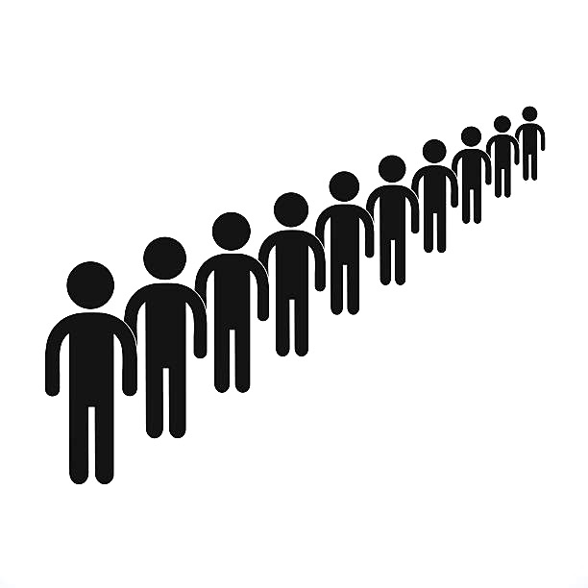
Motivation: Infection Spread
Infection network
Nodes as patients, edges formed among friends and family.
Only structure info available. Patients admitted not at the order they got infected.

Slide 7
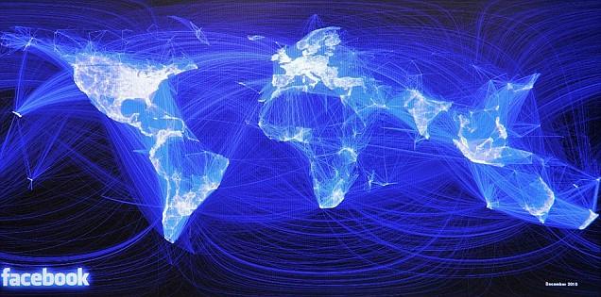
Further Motivation
Financial transaction networks: flow of capital
Spread of infectious diseases: origin and initial carriers
Social networks: spread of information
Network of biochemical reactions:
(protein-protein interaction network)
Study of the phylogenetic tree
Cancer proteins tend to be ancient proteins
[Srivastava et al., Nature 2010]
Ebola spread network
[Saey, ScienceNews Dec 2015]

Slide 8
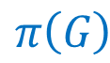

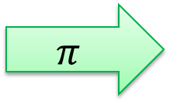
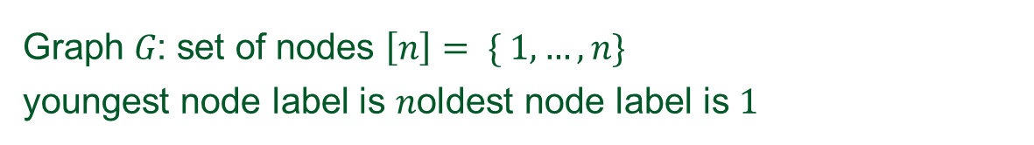
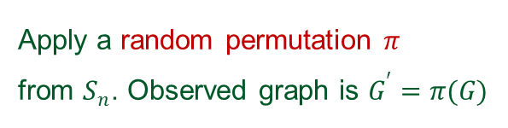
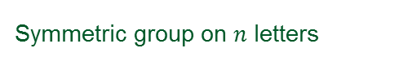
Formulation
Graph $G$: set of nodes $\left[n\right]= \{ 1,…,n\}$
youngest node label is $n$oldest node label is $1$
3
1
10
2
8
1
4
3
9
5
6
9
5
6
$$π$$
4
11
7
8
11
7
$$π\left(G\right)$$
$$G$$
12
2
12
10
Apply a random permutation $π$
from $S_{n}$. Observed graph is $G^{′}=π(G)$
Symmetric group on $n$ letters

Slide 9

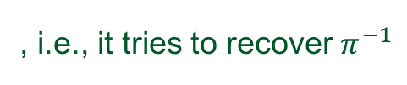
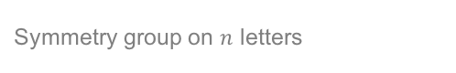
Minimax Risk
A node age recovery problem is a tuple
Distortion measure between permutations
Random graph model
Node age estimator is a function
Random adversary function
, i.e., it tries to recover $π^{−1}$
Set of graphs on $n$ vertices
Symmetry group on $n$ letters
Minimax risk for a random graph model and a distortion measure
Distortion measure
Relabeled graph
Random graph model
Estimator
Adversary distribution

Slide 10
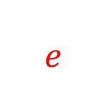
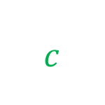
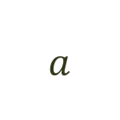
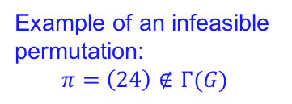
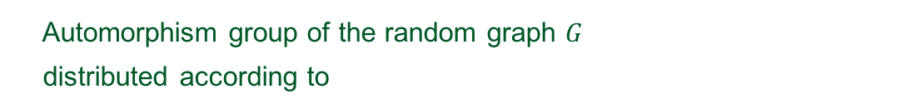
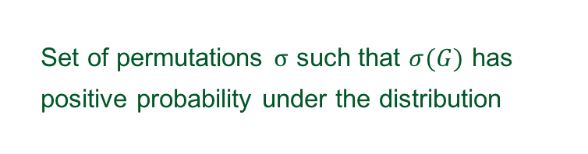
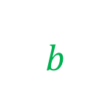
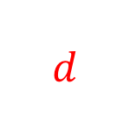
Lower Bounds on Minmax Risk
Sets of permutations associated with a random graph model
$$a$$
Automorphism group of the random graph $G$
distributed according to
$$c$$
$$b$$
Random graph model
$$d$$
$$e$$
Set of feasible permutations
Set of permutations $σ$ such that $σ(G)$ has
positive probability under the distribution
Example of an infeasible permutation:
$$π=\left(24\right)∉Γ(G)$$
Set of admissible graphs

Slide 11
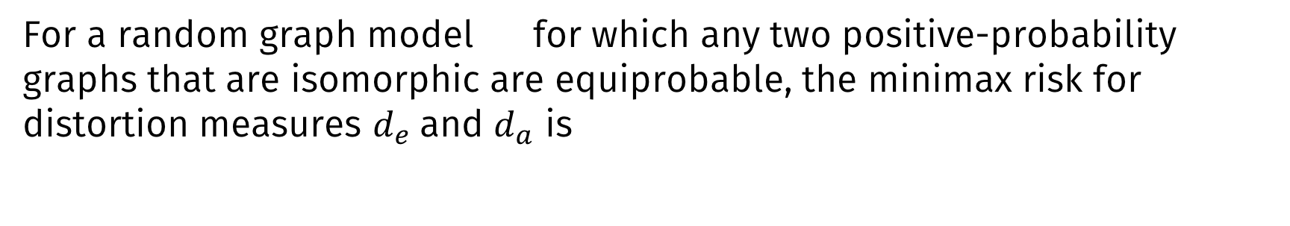
Lower Bounds on Minmax Risk (contd.)
Exact recovery
Approximate recovery
(Kendall Tau distance)
Theorem
For a random graph model for which any two positive-probability graphs that are isomorphic are equiprobable, the minimax risk for distortion measures $d_{e}$and $d_{a}$ is
Set of admissible graphs
Set of feasible permutations

Slide 12
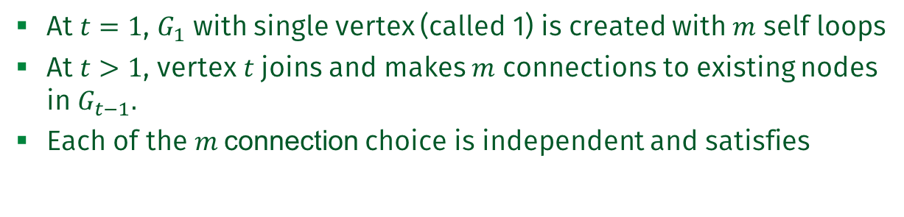
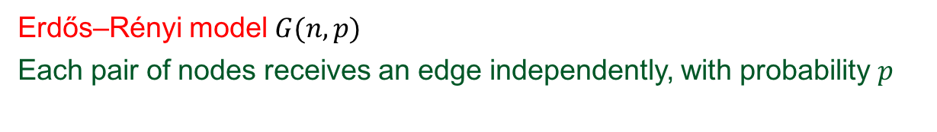
Erdős–Rényi and Preferential Attachment models
Erdős–Rényi model $G(n,p)$
Each pair of nodes receives an edge independently, with probability $p$
Preferential Attachment model
At $t=1$, $G_{1}$ with single vertex (called 1) is created with $m$ self loops
At $t>1$, vertex $t$ joins and makes $m$ connections to existing nodes in $G_{t−1}.$
Each of the $m$connection choice is independent and satisfies

Slide 13
Bad News!
Inapproximability result for Erdős–Rényi and preferential attachment graphs

Slide 14
Further Bad News!!
ML estimation is not a good approach
The maximum likelihood estimation solution set satisfies
with high probability.

Slide 15
Compression of graph structures
Theorem (Structural entropy for a broad class of graph models)
For a broad class of random graph models,

Slide 16
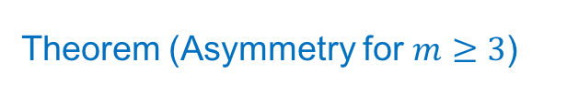
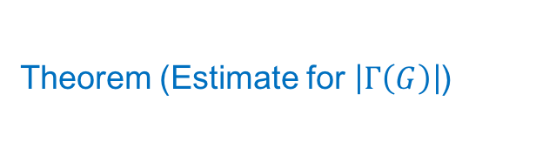
Results on combinatorial quantities: preferential attachment case
Theorem (Asymmetry for $m≥3$)
Theorem (Estimate for $\left|Γ\left(G\right)\right|$)

Slide 17
Structural entropy of preferential attachment graphs
Theorem

